Slide 1
Problem Solving Using Computers
Variables

Slide 2
VARIABLE
A variable is a name of storage location in memory that holds data.
Variables are used to store data which can be read and write during program execution.
Each variable has a Data type, which defines memory size and data
In C variables have to be declared before they are used Ex: int x;
Variable can’t be a keyword.

Slide 3
Variable names
Rules for valid variable names (identifiers) :
Name must begin with a letter or underscore ( _ ) and can be followed by any combination of letters, underscores, or digits.
Key words cannot be used as a variable name.
C is case-sensitive: sum, Sum, and SUM each refer to a different variable.
Variable names can be as long as you want, although only the first 63 (or 31) characters might be significant.
Choice of meaningful variable names can increase the readability of a program

Slide 4
Variable declarations
Data type Variable name;
Which data types
are possible in C ?
Which variable names
are allowed in C ?

Slide 5
Input Basics (scanf)
scanf("format_specifier", &variable);
int num;
printf("Enter a number (width 3): ");
scanf("%3d", &num); // reads max 3 digits

Slide 6
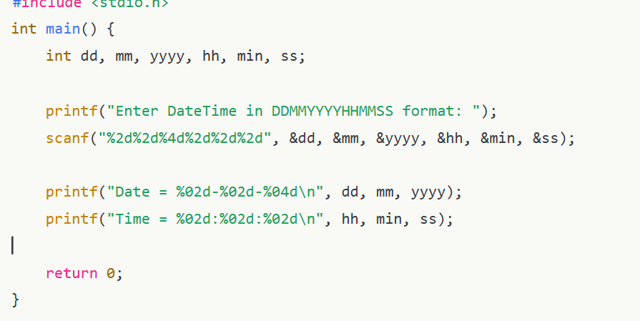
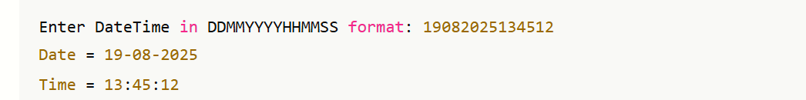

Slide 7
Float Data Type
:
Input and output
Format specifier with float
Width specifier with output

